Slide 1

GROUP 8
MLAI
CNN PRESENTATION
BY SHIQI & BOON SIONG
1 / 20
29 JAN, 2025

Slide 2


WELCOME
Objective
We aim to classify objects into three categories:
✔ Plastic Bottles : 1942 images
✔ Aluminum Cans : 1580 images
✔ Unknown white pictures : 1500 images
Our model will differentiate between plastic bottles and aluminum cans, while also handling objects that do not belong to either category.
2 / 20
29 JAN, 2025

Slide 3
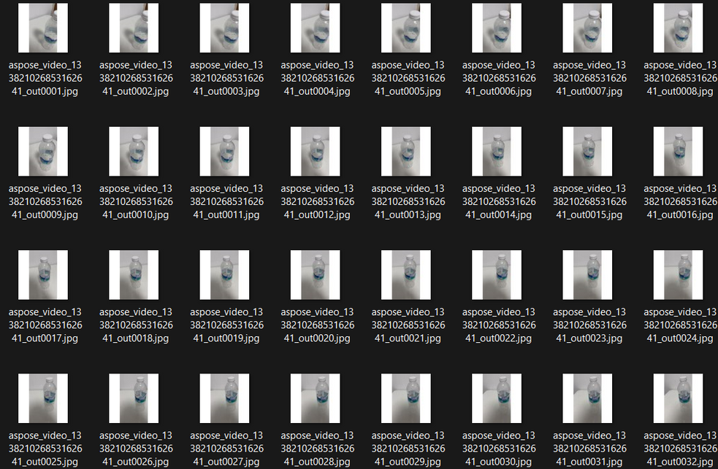
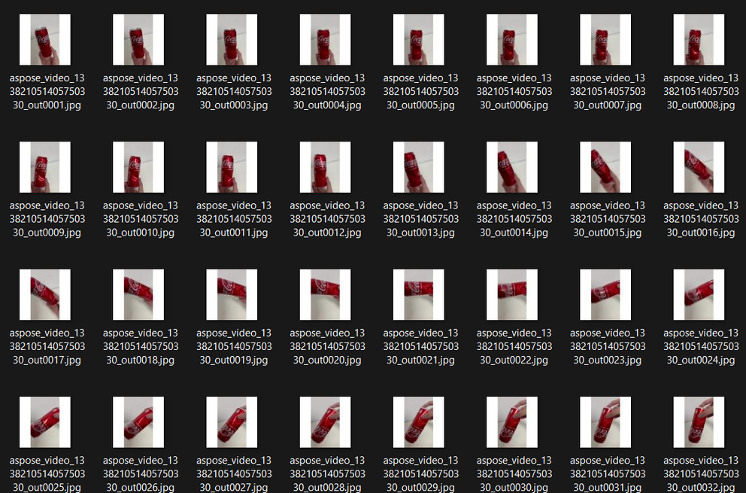
MODEL
Model Preparation
Before Training:
✔ Collected images from videos
✔ Extracted frames and resized them to 75x75 for
model processing
✔ Applied extensive tuning to prevent overfitting
3/ 20
29 JAN, 2025

Slide 4
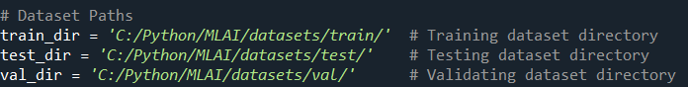
TARGET GROUP
Data Training
The dataset is split into three sets:
Training: Used for learning
Validation: Used to fine-tune model performance
Testing: Used to evaluate accuracy
4 / 20
29 JAN, 2025

Slide 5
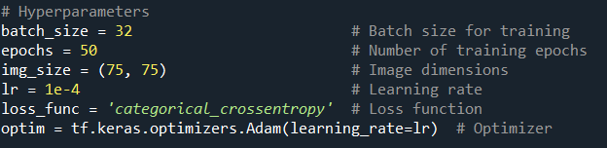
VALUE
Hyperparameters
Optimized hyperparameters for better model accuracy
✔ Final selected values:
Batch Size: 32
Epochs: 50
Image Size: 75 × 75
Learning Rate: 1e-4
Loss Function: Categorical Crossentropy
5 / 20
29 JAN, 2025

Slide 6
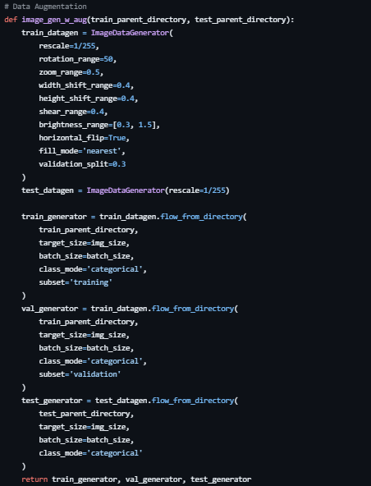
DATA
Data Augmentation
TECHNIQUES USED
Rescaling: Converts pixel values from 0-255 to 0-1 (rescale = 1/255).
Rotation: Randomly rotates images up to 50 degrees for diversity.
Zoom & Shift: Enhances variation by applying zoom, width & height shift.
Brightness & Flip: Adjusts brightness range (0.3 - 1.5) and flips images horizontally.
WHY
Prevents overfitting by introducing diversity in training samples.
Enhances model generalization to recognize objects from different perspectives.
6 / 20

Slide 7
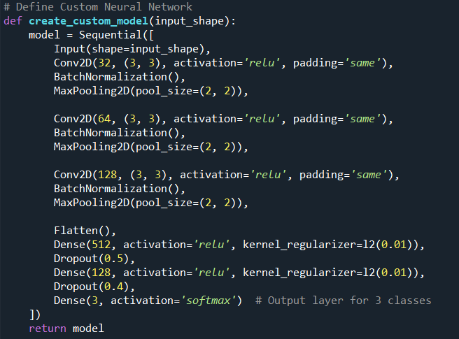
BUILDING
Model Building
Convolutional Layers (CNN):
Extracts key features using 3x3 filters.
Includes Batch Normalization for stable training.
Dense Layers:
512 & 128 neurons with ReLU activation.
L2 regularization to prevent overfitting.
Dropout Layers:
50% & 40% dropout to reduce overfitting risks.
Output Layer:
Softmax activation for classifying into 3 categories.
7 / 20
29 JAN, 2025

Slide 8
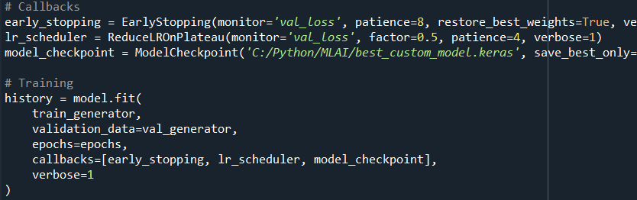
TRAINING
Model Training
Training Strategy:
EarlyStopping: Stops training when validation loss no longer improves.
ReduceLROnPlateau: Reduces learning rate if training stalls.
ModelCheckpoint: Saves the best model automatically.
Validation Set: Used to monitor performance and avoid overfitting.
Why These Techniques?
EarlyStopping prevents unnecessary training time.
ReduceLROnPlateau helps fine-tune learning rate dynamically.
ModelCheckpoint ensures only the best-performing model is saved.
8 / 20
29 JAN, 2025

Slide 9
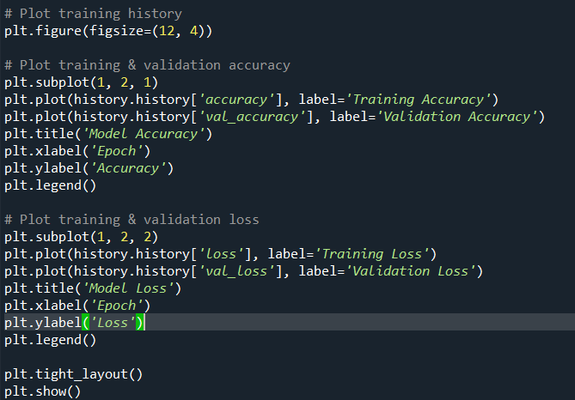
VISUALIZATIONS
Model Visualizations
Purpose:
Evaluate training performance across epochs.
✔ Visualization using matplotlib:
Accuracy vs. Epochs:
Compares training accuracy and validation accuracy.
Loss vs. Epochs:
Compares training loss and validation loss.
9 / 20
29 JAN, 2025

Slide 10
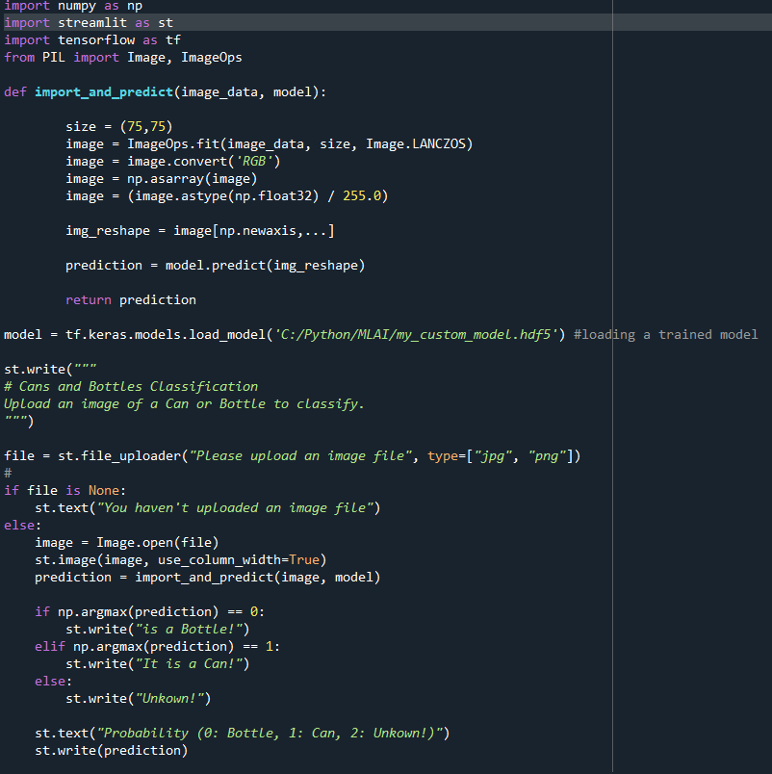
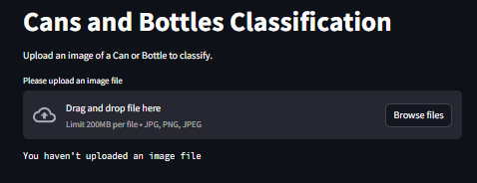
TESTING
Image Testing
Purpose:
Provides a user-friendly interface for testing the model.
Allows image uploads for classification.
Outputs predictions and probability scores.
✔ Implementation:
Built with Streamlit for easy interaction.
Uses a pre-trained model (my_custom_model.hdf5).
Supports image formats: JPG, PNG.
✔ How to Run:
streamlit run c:/python/mlai/mlai_app.py
10 / 20

Slide 11
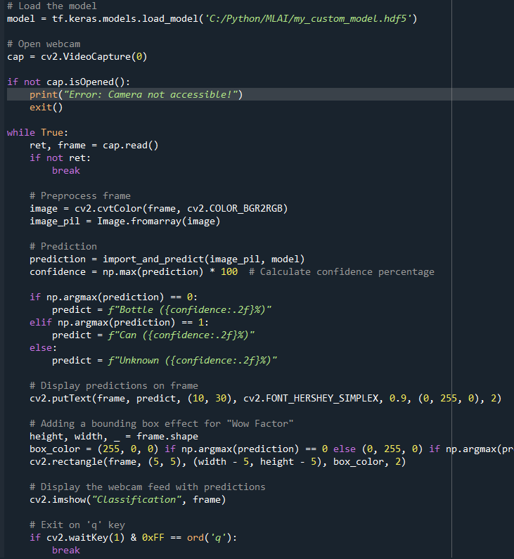
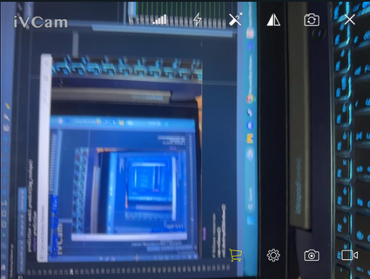
TESTING
Live Testing
Purpose:
Captures live webcam feed using OpenCV.
Detects and classifies objects in real-time.
Displays predictions along with confidence scores.
✔ Implementation:
Uses OpenCV to read frames from the webcam.
Preprocesses frames for model compatibility.
Predicts object category (Bottle, Can, or Unknown).
Displays results with bounding boxes and labels.
Supports external camera connections (e.g., iVCam for iPhone).
11 / 20
29 JAN, 2025

Slide 12
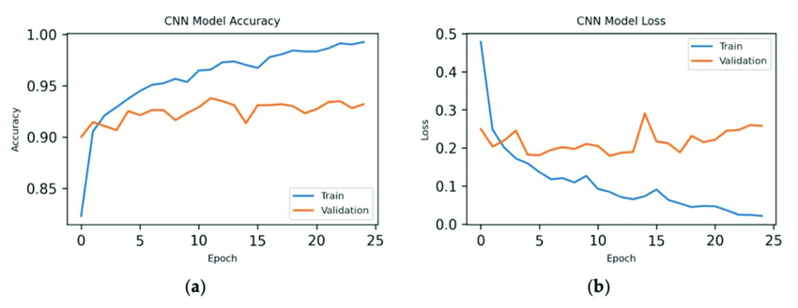
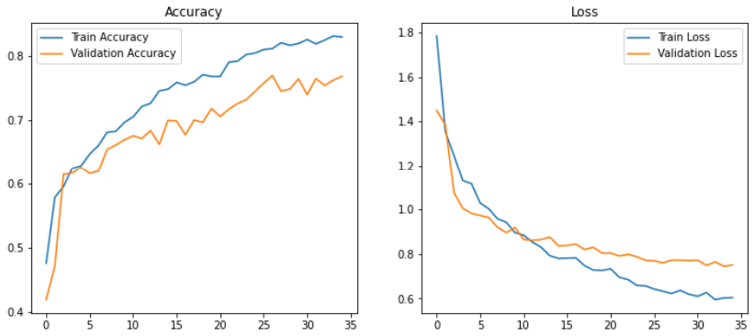
MODEL
Trained Model 5(Epoch 20)
High overfitting (validation accuracy fluctuating).
Large image size (150,150) increases computation.
Excessive dropout layers (4 layers: 0.6, 0.5, 0.4, 0.4).
Low learning rate (2e-6) slows convergence.
Trained Model 15(Epoch 30)
Still overfitting, but slightly improved generalization.
Smaller image size (75,75) reduces computational cost.
More regularization (2 layers) helps control overfitting.
Higher learning rate (1e-5) improves training efficiency.
12 / 20
29 JAN, 2025

Slide 13

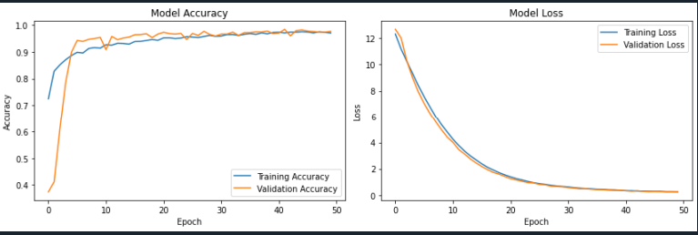
Best Trained Model 30(EPOCH 50)
Balanced Regularization (2 Layers, 0.5, 0.4) → Prevents overfitting without excessive dropout.
Optimal Learning Rate (1e-4) → Ensures faster and stable convergence.
Adam Optimizer → Adapts learning rate dynamically for better training.
Final Accuracy:
Training Accuracy: 0.9762
Validation Accuracy: 0.9807
Minimal validation loss (0.1973) → No severe overfitting
29 JAN, 2025

Slide 14
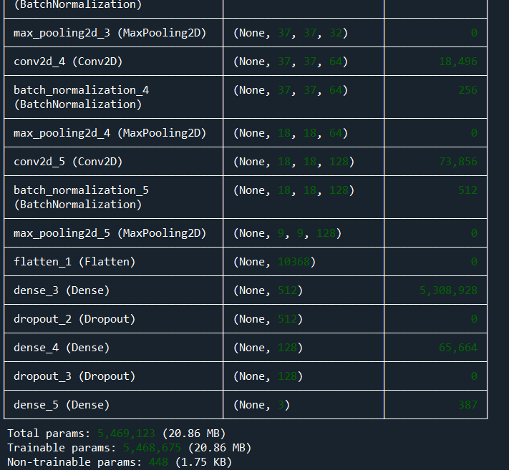
SUMMARY
Model Summary
✅ Total Parameters: 5,469,123
✅ Trainable Parameters: 5,468,675
✅ Non-Trainable Parameters: 448
Key Components
✔ Flatten Layer – Converts extracted features into a 1D vector.
✔ Dropout Layers – Prevents overfitting by randomly disabling neurons.
✔ Batch Normalization – Stabilizes training and improves efficiency.
✔ Dense Layers –
512 & 128 units (ReLU) for feature processing.
3 units (Softmax) for classifying bottle, can, or unknown.
14 / 20
29 JAN, 2025

Slide 15
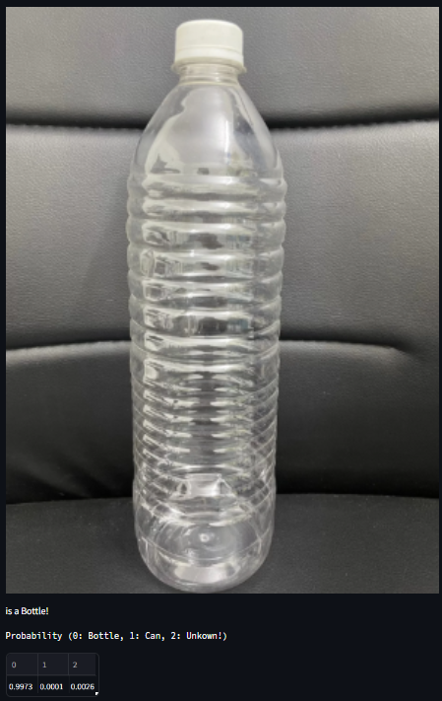

PLASTIC BOTTLE TEST
Accurate Classification
High Confidence
Real-Time Detection
THE MODEL CONFIDENTLY DETECTS PLASTIC BOTTLES IN BOTH IMAGE TESTING AND LIVE CAMERA TESTING.
PROBABILITY RESULTS SHOW 99.73% CERTAINTY FOR BOTTLES, CONFIRMING MODEL RELIABILITY.
THE SYSTEM EFFECTIVELY IDENTIFIES OBJECTS VIA WEBCAM FEED, MAKING IT PRACTICAL FOR REAL-WORLD APPLICATIONS.
15 / 20
29 JAN, 2025

Slide 16
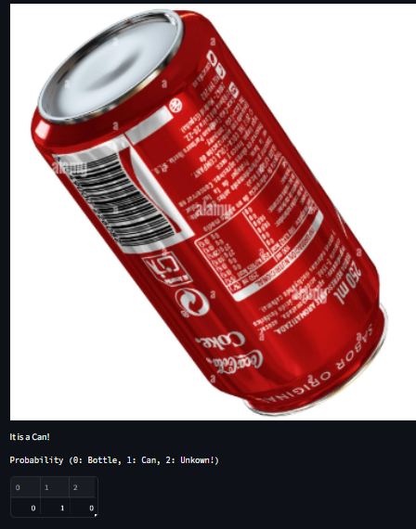
ALUMINUM CAN TEST
Accurate Classification
High Confidence
Real-Time Detection
THE MODEL SUCCESSFULLY CLASSIFIES ALUMINUM CANS IN BOTH IMAGE-BASED AND LIVE CAMERA TESTING.
MODEL PREDICTS 100% CERTAINTY FOR CANS, DEMONSTRATING STRONG RELIABILITY.
THE LIVE DETECTION SYSTEM EFFECTIVELY TRACKS OBJECTS THROUGH A WEBCAM FEED.
16 / 20
29 JAN, 2025

Slide 17
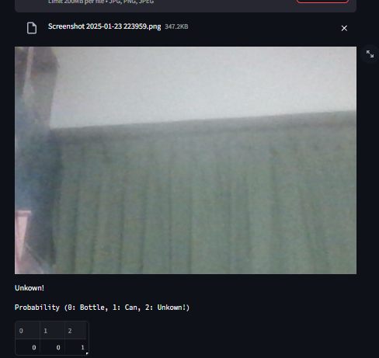
UNKNOWN OBJECT TEST
Effective Classification
High Confidence
Real-Time Detection
THE MODEL CORRECTLY IDENTIFIES NON-BOTTLE AND NON-CAN OBJECTS AS UNKNOWN.
THE SYSTEM DETECTS 100% CERTAINTY FOR UNKNOWN OBJECTS, ENSURING ACCURACY.
THE LIVE WEBCAM FEED CONFIRMS THAT UNRECOGNIZED OBJECTS ARE CLASSIFIED PROPERLY.
17 / 20
29 JAN, 2025

Slide 18
IMPROVE
Improvements
HOW?
To enhance model performance, we focused on three key areas, data, model tuning, and optimization. Increasing dataset diversity and applying K-Fold validation improved generalization. Adjusting learning rate, dropout values, and training epochs helped refine accuracy. Lastly, implementing model checkpoints ensured progress was saved efficiently, allowing for better experimentation and long-term optimization.
18 / 20
29 JAN, 2025

Slide 19
END
Conclusion
Our model faced challenges with overfitting, requiring careful adjustments to improve generalization. By enhancing dataset diversity, fine-tuning dropout and regularization, and optimizing hyperparameters, we achieved better balance between performance and accuracy. Key takeaways include the importance of data quality, model tuning, and progressive refinements to build a more robust and reliable classification system.
19 / 20
29 JAN, 2025

Slide 20
Thank You
29 JAN, 2025

